Slide 1

Week 5

Slide 2
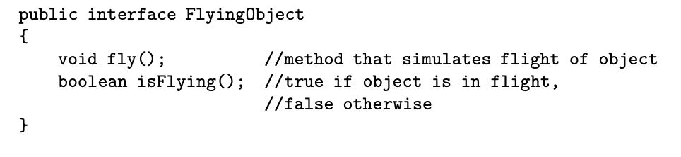
Recall: Defining an Interface
Notes:
11, 13, 14, 17, 18, 19,
10, 11, 16, 18, 19, 21, 22, 23

Slide 3
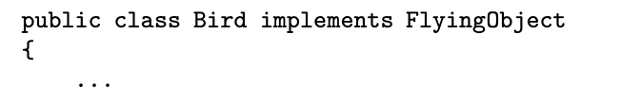
The implements Keyword
Two of the methods in the Bird class must be fly and isFlying
Any subclass of Bird will automatically implement the interface FlyingObject, since fly and isFlying will be inherited by the subclass

Slide 4
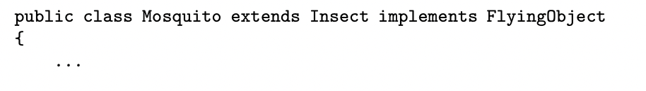
The implements Keyword
A class that extends a superclass can also directly implement an interface

Slide 5

Note
A class can only have one superclass, but implement any number of interfaces

Slide 6
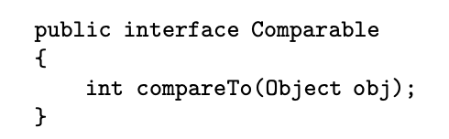
The Comparable Interface
Belongs to the standard java.lang package
Any class that implements Comparable must provide an implementation for the compareTo method
compareTo returns a negative integer, zero, or a positive integer depending on whether this is less than, equal to, or greater than the parameter

Slide 7
Abstract Class vs. Interface
Consider writing a program that simulates a game of Battleships
The program may have a Ship class with subclasses Submarine, Cruiser, Destroyer, etc
The various ships will be placed in a two-dimensional grid that represents a part of the ocean
Should we use abstract class or interface for Ship and Grid?

Slide 8
Abstract Class vs. Interface
An abstract class Ship is a good design choice, because we will not create any Ship, but the subclasses of Ship
A Grid interface can have methods that manipulate objects
The abstract Ship class is specific to the Battleships application, the Grid interface is not; we can use the Grid interface in any program that has a Grid

Slide 9
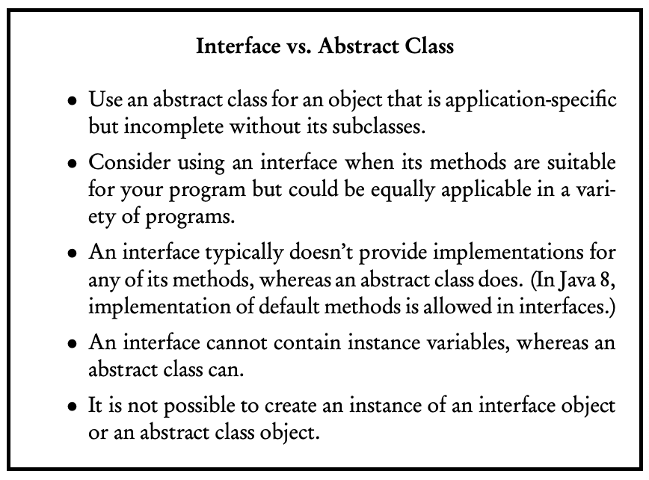

Slide 10
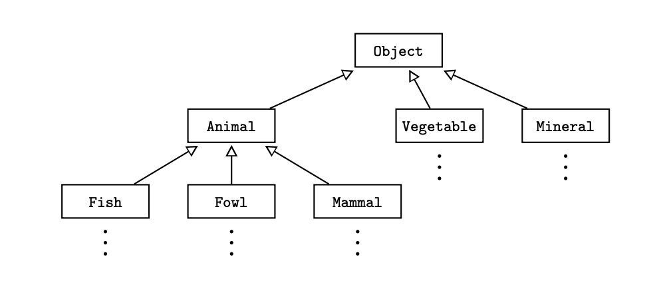
The Object Class
Object is the superclass of the universe
Every class automatically extends Object, which makes Object a direct or indirect superclass of every other class

Slide 11
Methods in Object
Object is not an abstract class, so all of its methods have implementations
The expectation is that these methods will be overridden in any class where the default implementation is not suitable

Slide 12



Returns a version of your object in String form
When you attempt to print an object, the inherited default toString method is invoked, which prints the address in memory of the object
Notes:
Ryan

Slide 13
To have more meaningful output, we should always override the toString method for our own classes
Helps with debugging

Slide 14
Returns true if this object and other are the same object, false otherwise
Being the same object means referencing the same memory slot
Often, we may want two objects to be considered equal if their contents are the same, so we have to override the equals method to achieve this

Slide 15
The hashCode Method
Every object is associated with an integer value called hash code
Objects are equal by default when they have a same hash code

Slide 16
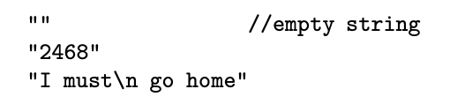
The String Class
An object of type String is a sequence of characters
String literals consist of zero of more characters, including escape sequences, surrounded by double quotes

Slide 17




The String Class
String objects are immutable, so there are no methods to change them after they’ve been constructed; however, you can create a new String and replace an existing String

Slide 18
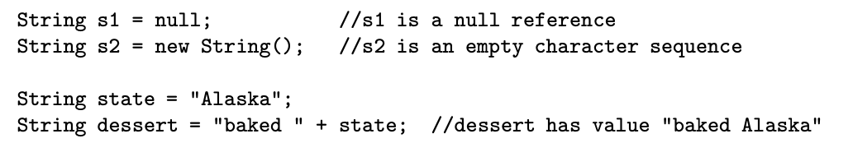
Concatenation Operator: +

Slide 19

Comparison of String Objects
Returns true if string1 and string 2 are identical strings, false otherwise
Compares strings in dictionary (lexicographical) order
If string1.compareTo(string2) < 0, then string1 precedes string2 in the dictionary

Slide 20
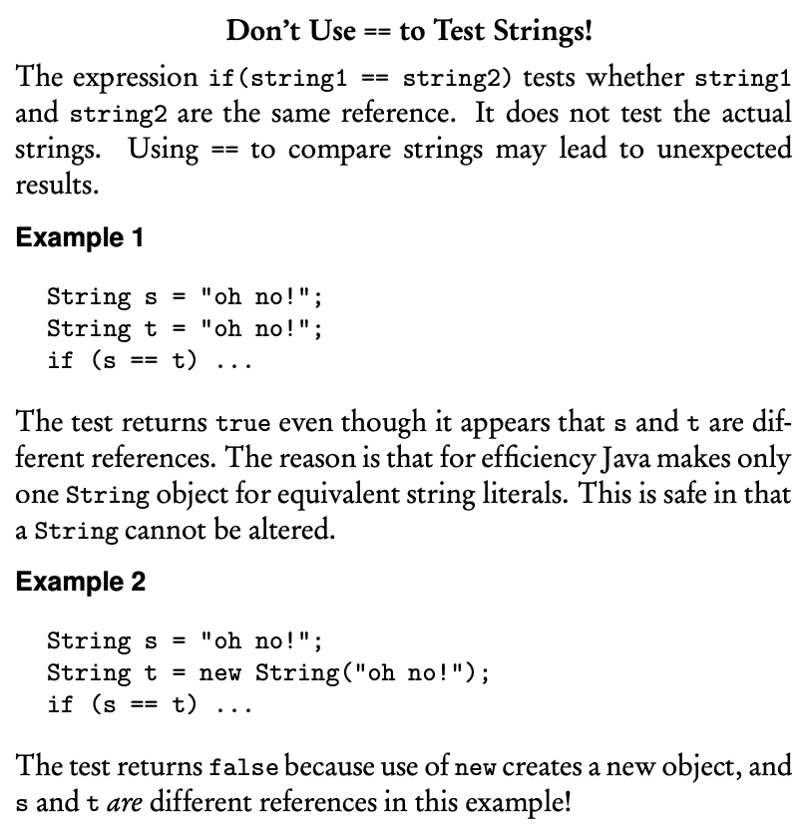

Slide 21



Other String methods

Slide 22
Wrapper Classes
Takes either an existing object or a value of primitive type, “wraps” it in an object, and provide a new set of methods for that type
allows construction of an object from a single value (wrapping or boxing the primitive in a wrapper object)
allows retrieval of the primitive value (unwrapping or unboxing from the wrapper object)

Slide 23





The Integer Class
The Integer class wraps a value of type int in an object, an object of type Integer contains just one instance variable whose type is int

Slide 24





The Double Class
The Double class wraps a value of type double in an object
An object of type Double contains just one instance variable whose type is double

Slide 25




The Math Class
Implements standard mathematical functions and contains some mathematical constants

Slide 26

Random Numbers
Produces a random real number in range 0.0 to 1.0, where 0.0 is included and 1.0 is not
We can scale or shift this range to transform he original interval 0.0 <= x < 1.0

Slide 27
Hi

Slide 28
Hi

Slide 29
Hi

Slide 30
Hi

Slide 31
Hi

Slide 32
Hi

